Slide 1
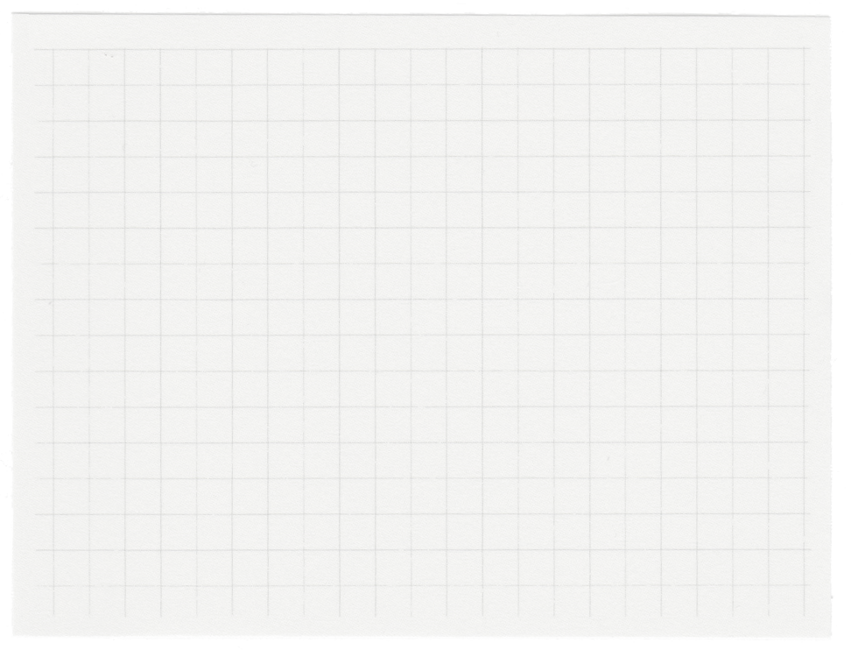





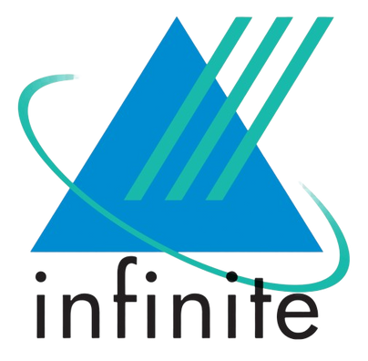








Internship Project Presentation
Presented by Avantika D
Mentor Name: Ezhil Murugan D

Slide 2
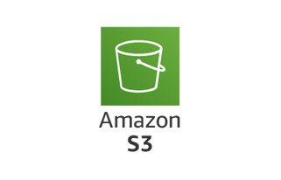
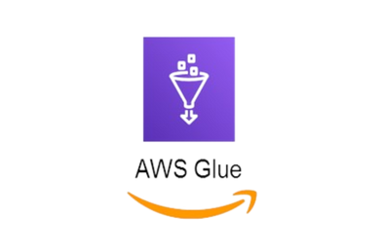

Project Objectives
Creating Visual ETL using AWS Glue
Visual ETL in AWS provides a user-friendly, drag-and-drop interface to design, manage, and monitor ETL workflows. Accessible through AWS Glue Studio, it simplifies building data pipelines. This visual approach allows data engineers, analysts, and other users to create ETL jobs by visually configuring data sources, transformations, and destinations.
01.
The objectives include understanding what ETL jobs are, how they are created and the concepts revolving around them.
Understading ETL:
Extract - Gathering data from databases, files, APIs, or streaming platforms.
Transform - Involves cleaning, structuring, and manipulating the data to fit the requirements.
Load - Processed data is stored in destinations like data warehouses, data lakes, or operational databases.
Configure AWS Glue to integrate S3 buckets, databases, and streams securely for data ingestion.
Creating ETL job using Glue Notebook
Creating ETL job with Glue Notebook involves using PySpark, connecting to data sources, and using PySpark's DataFrame API for transformations like filtering and joining. The transformed data is then written to the destination. Glue Notebook provides an interactive environment for testing and refining ETL code, enhancing debugging and development.
02.
.
Tools used:
AWS S3 (Simple Storage Service): scalable, secure object storage service for storing and retrieving data globally.
AWS Glue: Managed ETL service for data preparation and loading, supporting diverse sources with scalable processing.
Amazon QuickSight: Cloud-based BI service for creating visual insights from diverse data sources quickly and interactively.
Data Visulisation using QuickSight
03.
QuickSight simplifies data visualization with intuitive dashboards and diverse chart options. It connects seamlessly to various data sources, enabling users to create insightful visual representations like charts and graphs. QuickSight's user-friendly interface supports interactive exploration and sharing of data-driven insights for informed decision-making.

Slide 3
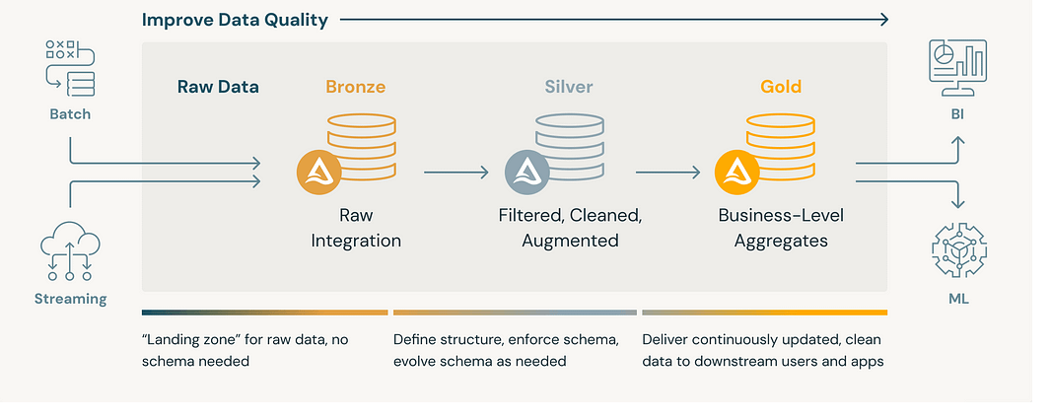
Understanding Medillion Architecture
Medallion architecture organizes data in a lakehouse, aiming to enhance data structure and quality across Bronze, Silver, and Gold layer tables.
This approach, also known as a "multi-hop" architecture, facilitates incremental data improvement through each layer.
The data warehouse is organized into tiers, with each tier serving a specific purpose in the data processing journey.
Raw data: This is the unprocessed data, sourced from various origins, enter in structured, semi-structured, or unstructured forms. It is initially in the "landing zone" without a schema.
Bronze tier: Raw data is processed to filter, cleanse, and standardize it. Tasks include removing duplicates, correcting errors, and applying a schema for data structure rules.
Silver tier: The data is further refined and integrated with data from other sources. Business rules can be applied in the silver tier to transform the data into a format that is more useful for analysis.
Gold tier: Final layer of processing in the data warehouse. It contains the most aggregated and summarized data, which is ready for use by BI and analytics tools. The data in the gold tier is typically refreshed on a periodic basis.

Slide 4
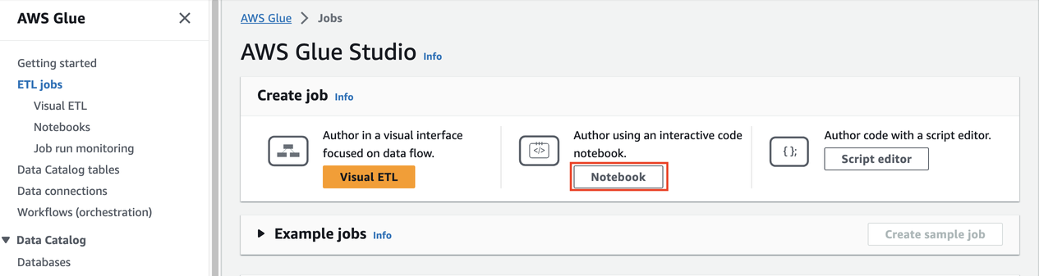

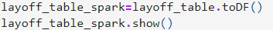
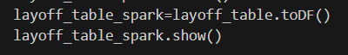
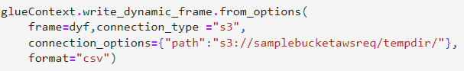
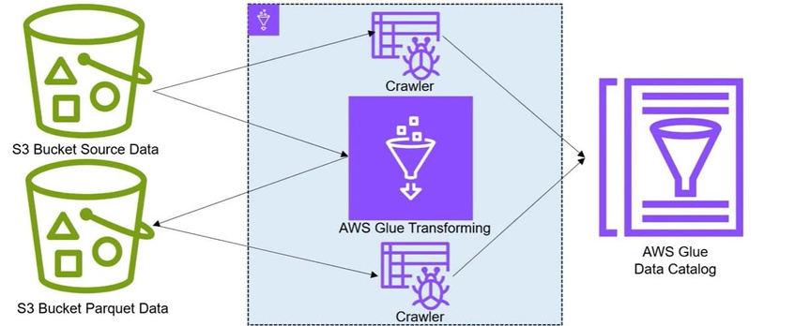
Creating ETL Jobs
1. ETL job using Glue Notebook
PySpark - Python API for Apache Spark, a powerful open-source distributed computing framework. Utilized for scalable data processing tasks, leveraging its ability to handle large-scale data transformations and analytics seamlessly. It integrates well with AWS Glue's ETL capabilities, offering flexibility in data manipulation and computation within cloud environments.
DynamicFrame in Spark - This type of DataFrame, often referred to as a Dataset in Spark, supports schema evolution and allows for dynamic column addition or modification during runtime.
Spark DataFrame - are structured, distributed collections of data offering SQL-like operations for efficient data manipulation. They support schema-on-read, immutability, and lazy evaluation, optimizing performance across distributed computing nodes.
Code converting the spark to dynamic frame and saving the dataframe at the end:
2. Visual ETL
AWS Glue Studio simplifies data integration by offering a visual interface to build ETL pipelines. Components can be dragged and dropped to define data transformations which include filtering rows, join datasets, or apply data quality checks.
Once transformations are defined, the target location for data is selected, like an S3 bucket or data lake. Finally, ETL job is scheduled to run at regular intervals.
This visual approach makes data pipelines accessible to a wider range of users and reduces errors. It also fosters collaboration between data engineers and business analysts.
AWS Glue Crawler automatically discovers and catalogs metadata about data sources, simplifying data integration and management.

Slide 5
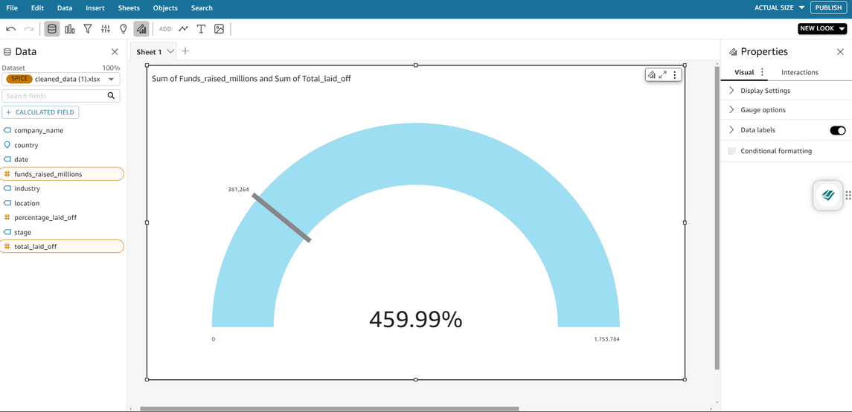
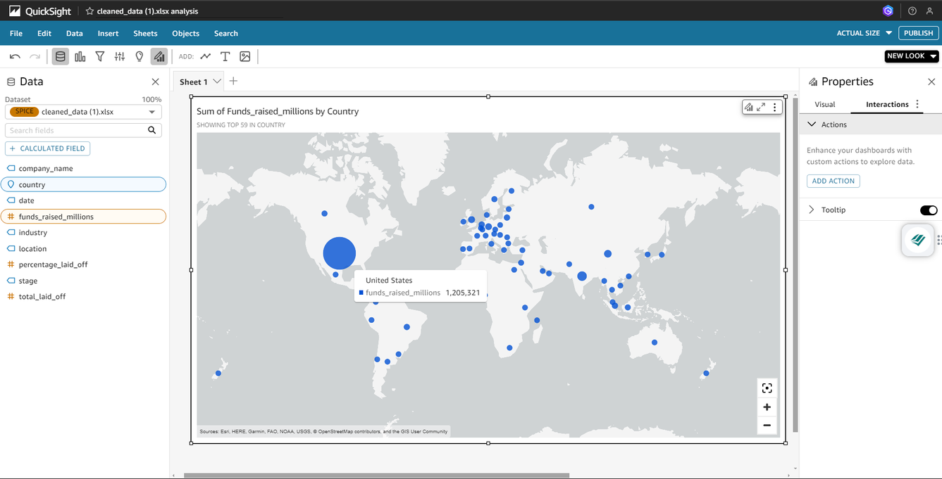
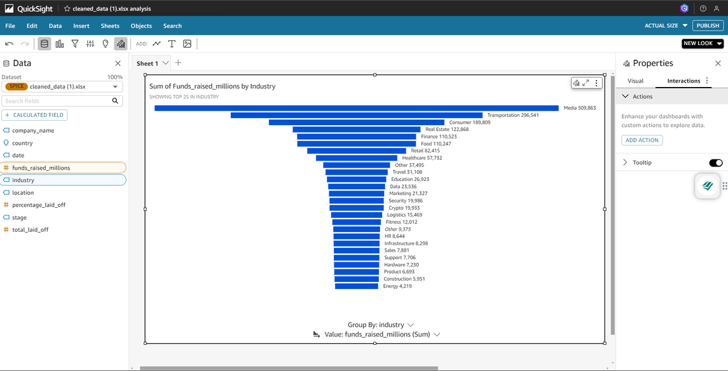
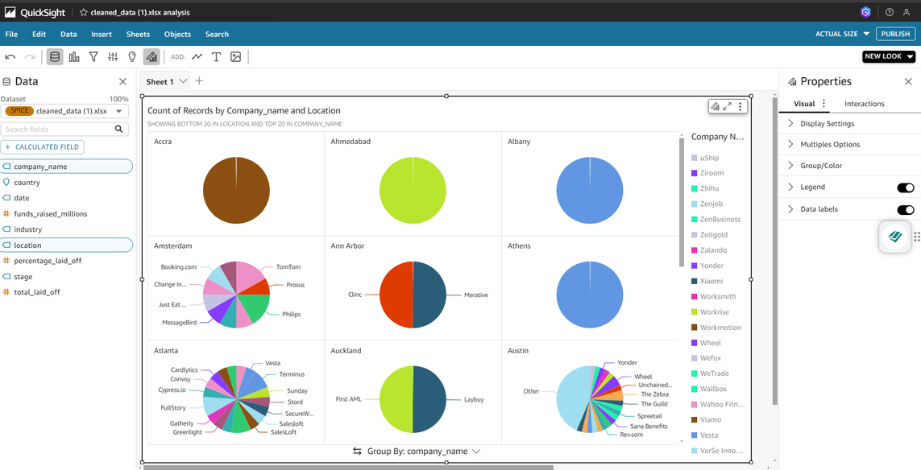
Data Visualization
Amazon QuickSight simplifies data visualization with intuitive dashboards and visualizations that can be created in just a few clicks.
It supports a variety of data sources, including AWS services like Redshift, S3, and RDS, as well as third-party sources like Salesforce and Snowflake. QuickSight's drag-and-drop interface allows users to build interactive charts, graphs, and maps without needing extensive coding skills.
Complex datasets into intuitive and easily interpretable visuals, enabling quicker insights and better decision-making. By presenting data graphically, patterns, trends, and anomalies become more apparent, allowing stakeholders to grasp critical information at a glance.

Slide 6

Thank You!

